Slide 1
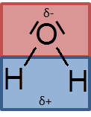

Slide 2
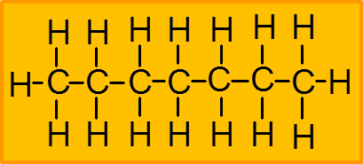

Slide 3
δ-
δ+
δ-
δ+
δ-
δ+
δ-
δ+
δ-
δ+
δ-
δ+
δ-
δ+
δ-
δ+
δ-
δ+
δ-
δ+
δ-
δ+
δ-
δ+
δ-
δ+
δ-
δ+
δ-
δ+
δ-
δ+
δ-
δ+
δ-
δ+
δ-
δ+
δ-
δ+
δ-
δ+

Slide 4
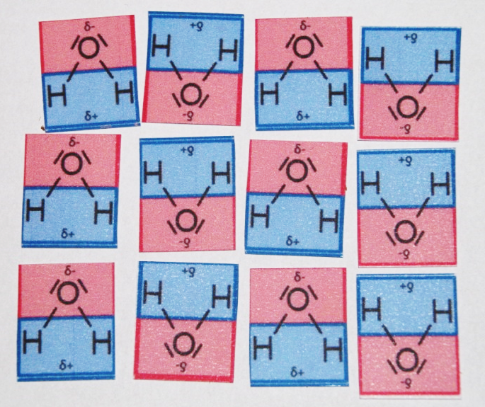
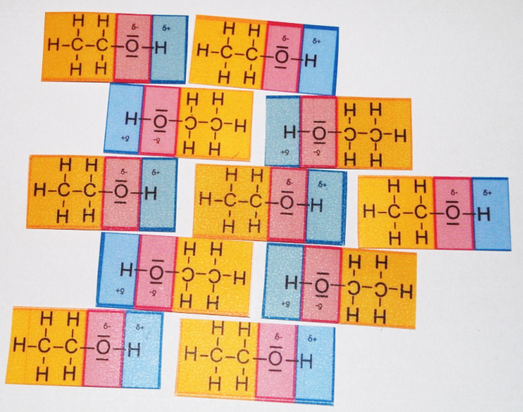
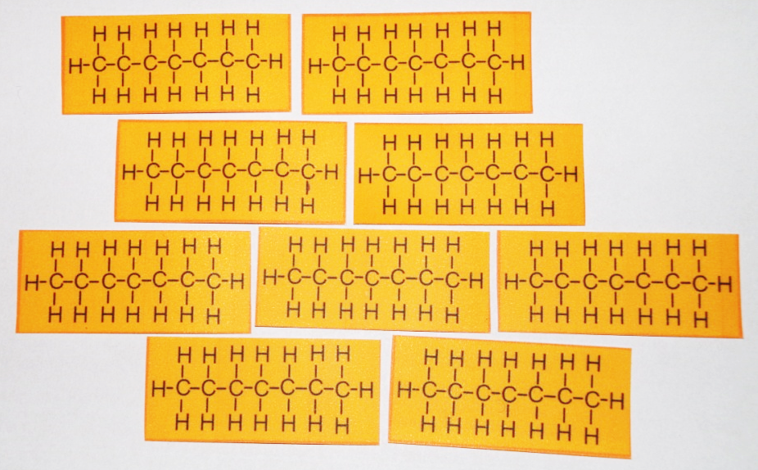
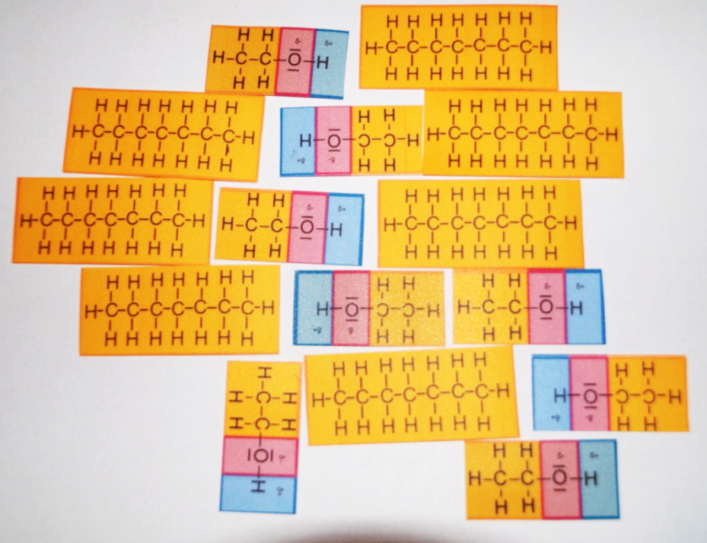
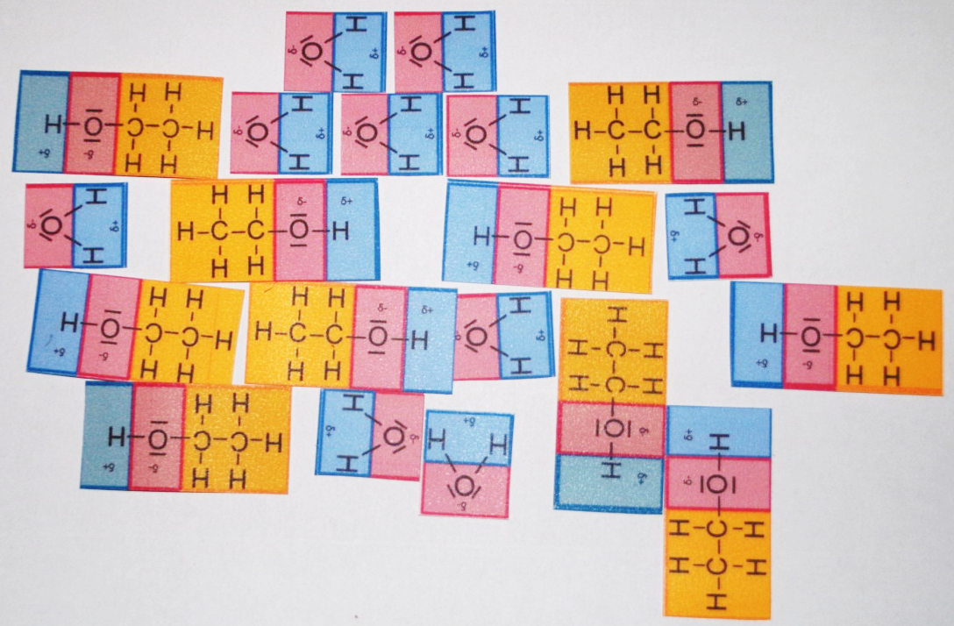
Wasser
Ethanol
Heptan
Ethanol in Heptan
Ethanol in Wasser

